Slide 1
Anecdotes and tips to advance your career
Jon Mitchiner
Deaf in Government
One Day Seminar
3/19/2015

Slide 2
My Background
Early years
Minotaur Technologies (1996 - 2002)
Gallaudet University (2002 - 2012)
Internal Revenue Service (2012 - 2014)
Department of Health and Human Services (2014 - Present)

Slide 3
What is your role?

Slide 9
Management Pet Peeves

Slide 11
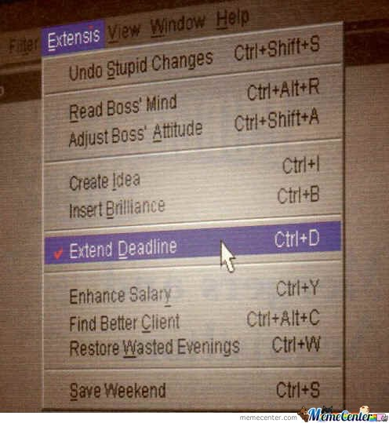

Slide 15
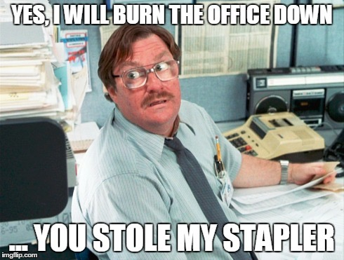

Slide 16
Tips for career advancement

Slide 18
Role, names, acronyms

Slide 19
Debrief Afterwards

Slide 22
