Slide 1
SOCIAL MEDIA TIPS WITH RICARDA FREYDEL
LEARN HOW TO CREATE UNIQUE AND ENGAGING CONTENT
TO SHARE ON SOCIAL MEDIA

Slide 2
WHAT IS SOCIAL MEDIA?

Slide 3
Who am I? Ricarda Freydel
MY BACKGROUND WITH SOCIAL MEDIA
Rica’s Home 19.2K followers
@justricarda 30.7K followers
@rica_life

Slide 4
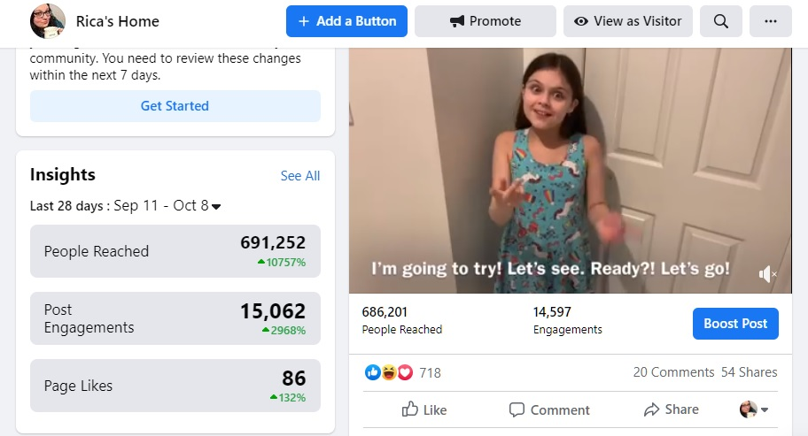
How did I start? How am I doing now?

Slide 5
WHY IS SOCIAL MEDIA IMPORTANT?
You can increase influence, inform, sell/promote to your followers and much more
The impact on our Deaf community
Please consider making it accessible to ALL

Slide 6
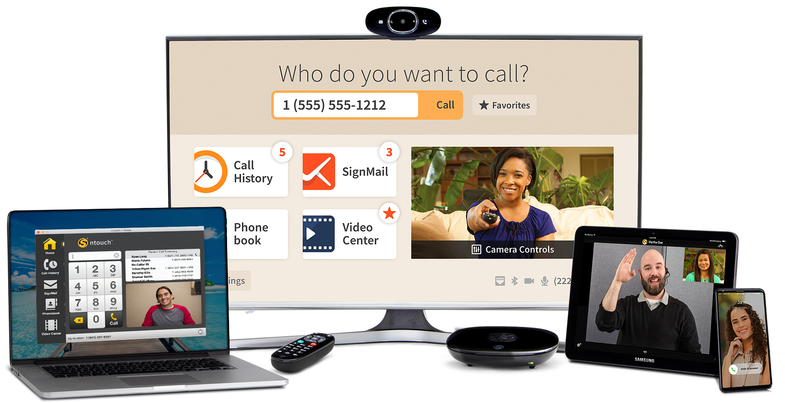
WHAT CAN SORENSON OFFER?

Slide 7
WHAT CAN SORENSON OFFER?
GROUP CALLS
ESPANOL VRS
WAVELLO
CONFERENCE CALLS

Slide 8
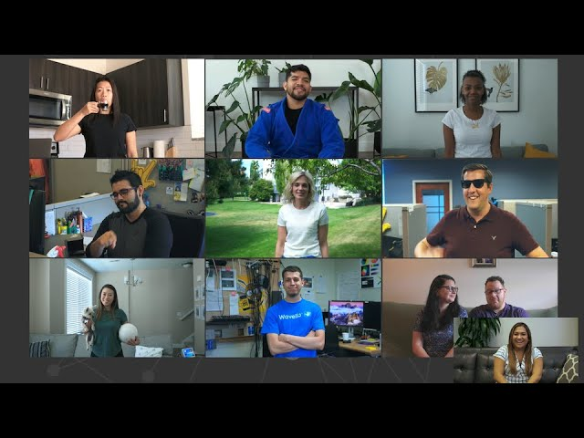
GROUP CALLS
INCLUDE MORE. SEE MORE.

Slide 9
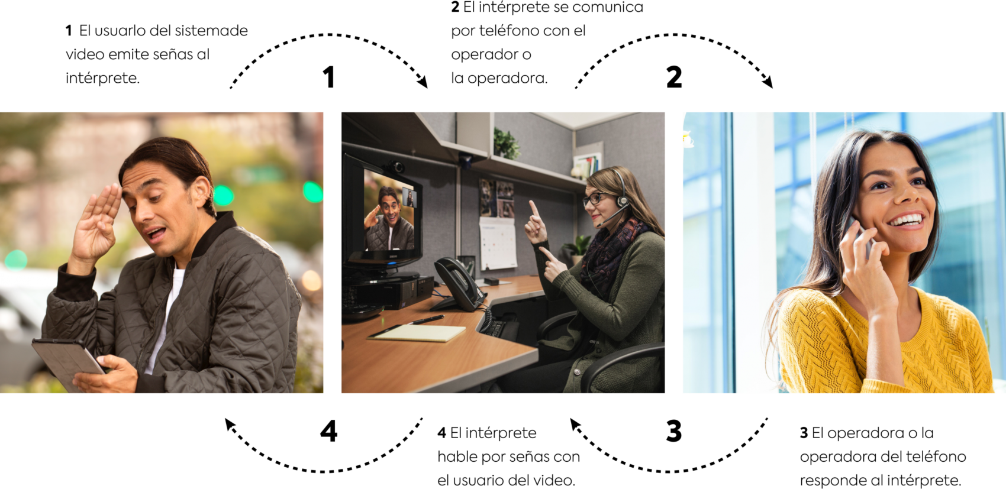
ESPANOL VRS

Slide 10
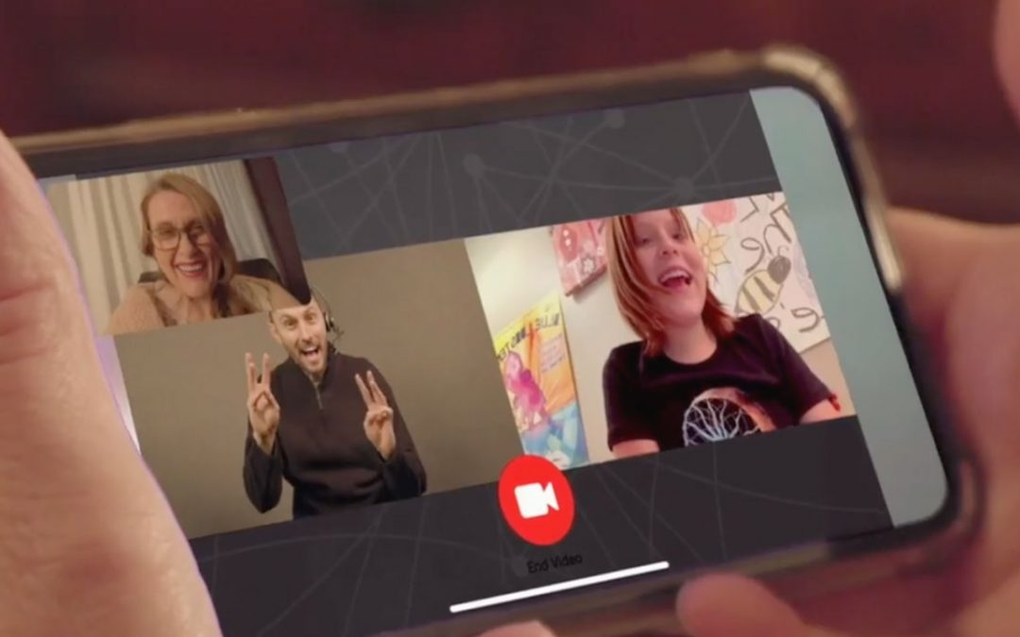
WAVELLO
BE SEEN!
Wavello is a VRS call supported with video – everyone on the call, including the Deaf person, the hearing person, and the interpreter, can be seen.

Slide 11
CONFERENCE CALLS
Have ideas or content to share with your peers? Do you need to use Zoom, Google chat, Teams, or another conference call platform? Our Sorenson Relay interpreters are always ready to interpret your call. Simply enter the Dial-in number for your meeting on your nTouch device. A Sorenson Relay interpreter will call into your meeting via audio and interpret for you.

Slide 12
The fun part! How to develop or improve your social media presence
DO what you LOVE! You need to know your stuff!
KNOW your customer base/demographics.
STAND out from the rest!
KEEP the followers/customers coming back for more.

Slide 13
WHAT MAKES CONTENT GOOD?
GOOD PICTURES / VIDEOS
PEOPLE DON’T JUST SHARE INFORMATION. THEY SHARE STORIES.
WHAT KIND OF STORIES?
NEWS, TRENDING ISSUES, HUMOR, ENTERTAINMENT, GUEST STARS, COLLABORATIONS, ETC

Slide 14
FREQUENCY
HOW OFTEN DO YOU POST?
WHEN DO YOU POST?
You don’t want to spam or infrequently post.
Study and understand the time it takes to hit the mass audience.
Know your magic number (48 hours for me in my personal experience).
Find out the best times for your audience.
Know your peak days and peak times.
Figure out which day/time that your followers engage with your content the most.

Slide 15
How to engage with your customers/followers:
Commenting on posts and/or replying to comments
Starting and participating in conversations
Sharing relevant information
Posing and answering questions
Addressing complaints and criticisms
Showing appreciation for followers/customers
REMEMBER! Social Media does not mean posting something then walking away. To be effective you must ENGAGE with your customers and/or followers!

Slide 16
conclusion
KNOW your platforms
IMPROVE your social media presence
IMPLEMENT your strategies
STUDY the peak days/times for your social media account(s)
ENGAGE with your followers/customers
CREATE goals (more engagements, more likes, better metrics, etc.)
Sorenson is here with you to help you with our products and services.
Please visit www.sorenson.com

